Slide 1
Principles of Compiler Construction
Lecture 3 Lexical Analysis (II)
Lecturer: Chang Huiyou
Note that most of these slides were created by:
Prof. Wen-jun LI (School of Software) Dr. Zhong-mei SHU (Department of Computer Science) Dr. Han LIN (Department of Computer Science)

Slide 2
练习
用正则表达式描述下列语言：
不以ab开头的所有只含有字母a和b的字符串.
Notes:
(aa|bb|ba)(a|b)*

Slide 3
A Big QUESTION
How to identify and process regular expression?
regular expression
NFA
DFA

Slide 4
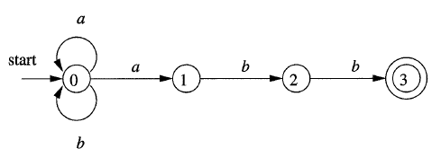
Eaxmple：NFA
L: (a|b)*abb

Slide 5
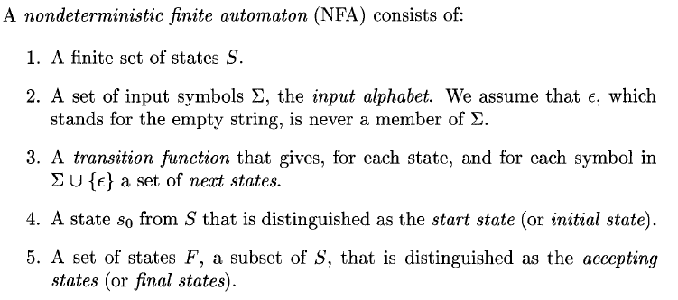
NFA
The language defined (or accepted) by an NFA is the set of strings labeling some path from the start to an accepting state.

Slide 6
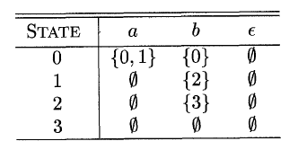
Transition Table
A transition function can be represented by a transition table. Eg:

Slide 7
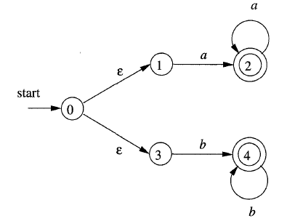
Example：NFA with є
L: aa*|bb*

Slide 8
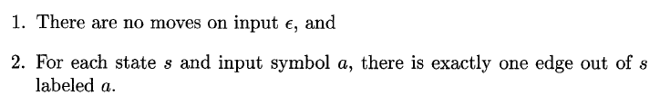
DFA
A deterministic finite automaton (DFA) is a special case of an NFA where:

Slide 9
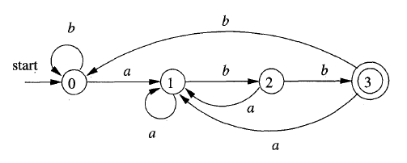
Example
(a|b)*abb

Slide 10
Transition Function: Move
Transition function (table): move(s, c)
 | a | b
s0 | s1 | s0
s1 | s1 | s2
s2 | s1 | s3
s3 | s1 | s0

Slide 11
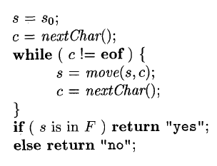
DFA
O(|x|)，x is input string，|x| is the length of x

Slide 12
More…
DFA?
Regular Expression to NFA?
NFA to DFA?
OK, let’s try!

Slide 13


From Regular Expression to NFA

Slide 14
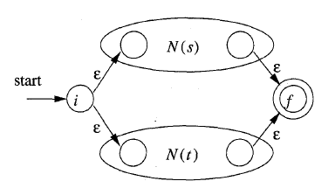
From Regular Expression to NFA

Slide 15

From Regular Expression to NFA

Slide 16
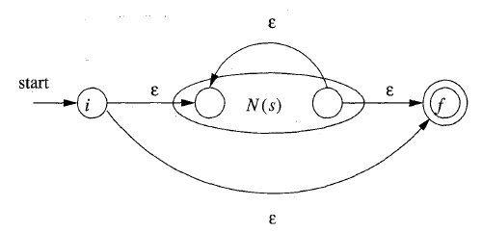
From Regular Expression to NFA

Slide 17


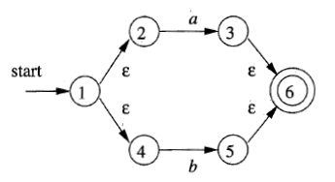
Example
Construct an NFA for (a|b)*abb
a
b
a|b

Slide 18
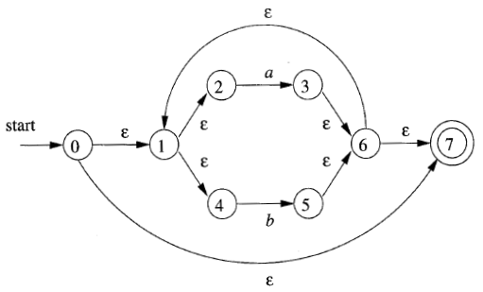
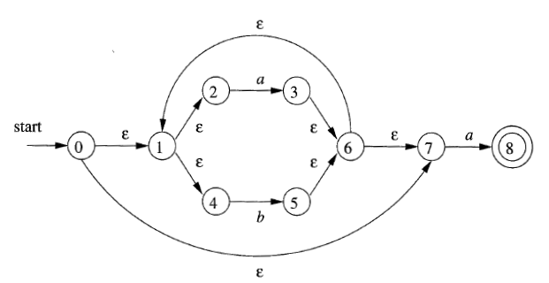
Example
(a|b)*
(a|b)*a

Slide 19
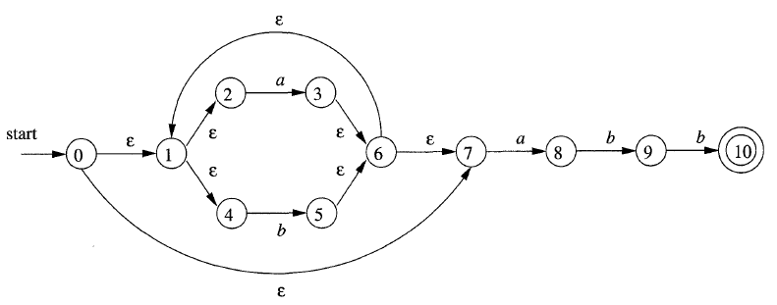
Example
(a|b)*abb

Slide 20
From NFA to DFA
一些记号：
e.g.
Є-closure(0)={0, 1, 2, 4, 7}

Slide 21

From NFA to DFA
e.g.

Slide 22
From NFA to DFA
e.g.
move({0, 1, 2, 4, 7}, a) = {3, 8}

Slide 23
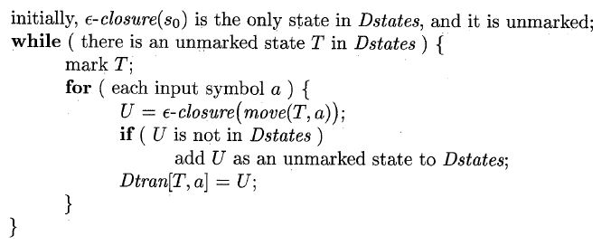
Subset Construction
Algorithm:Subset Construction
Input: An NFA N
Output: A DFA D accepting the same language as N
Method: Each state of D is a set of NFA states. The algorithm constructs a transition table Dtran for D.

Slide 24
Example

Slide 25
Example
NFA states | DFA state | a | b
{0, 1, 2, 4, 7} | A | B | C
{1, 2, 3, 4, 6, 7, 8} | B | B | D
{1, 2, 4, 5, 6, 7} | C | B | C
{1, 2, 4, 5, 6, 7, 9} | D | B | E
{1, 2, 4, 5, 6, 7, 10} | E | B | C

Slide 26
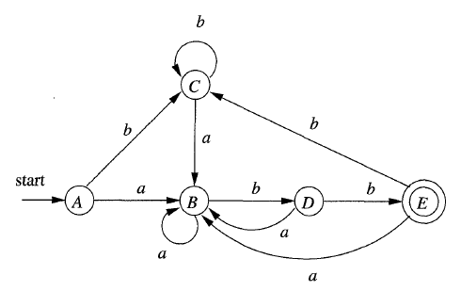
Example
NFA states | DFA state | a | b
{0, 1, 2, 4, 7} | A | B | C
{1, 2, 3, 4, 6, 7, 8} | B | B | D
{1, 2, 4, 5, 6, 7} | C | B | C
{1, 2, 4, 5, 6, 7, 9} | D | B | E
{1, 2, 4, 5, 6, 7, 10} | E | B | C

Slide 27
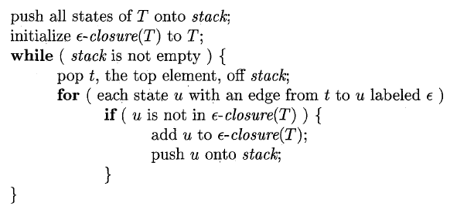
Computing Є-closure(T)

Slide 28
conclusion

RegularExpression
NFA
DFA


Slide 29
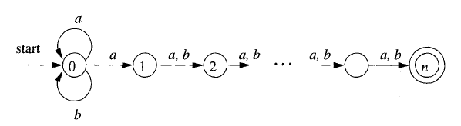
From NFA to DFA
Disadvantage
2^n ?

Slide 30

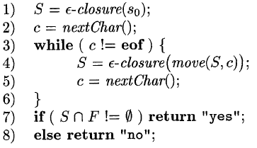
NFA

Slide 31
Discussion
DFA?
NFA?

Slide 32
重要结论
定理：对任何DFA D都存在一个正则表达式r，使得L(D)=L(r).
推论：对任何NFA N都存在一个正则表达式r，使得L(N)=L(r).
结论：DFA，NFA和正则表达式三者的描述能力是一样的.

Slide 33
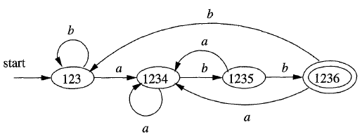
比较
上图比下图少了一个状态
问题：如何使得DFA的状态数最少？

Slide 34
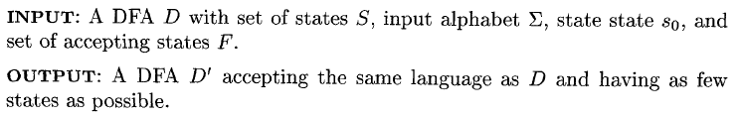
DFA的最小化

Slide 35
Basic Idea
String x distinguishes state s from state t if exactly one of the states reached from s and t by following the path with label x is an accepting state.
State s is distinguishable from state t if there is some string that distinguishes them.
例如，左图中字符串bb区分状态B和C

Slide 36
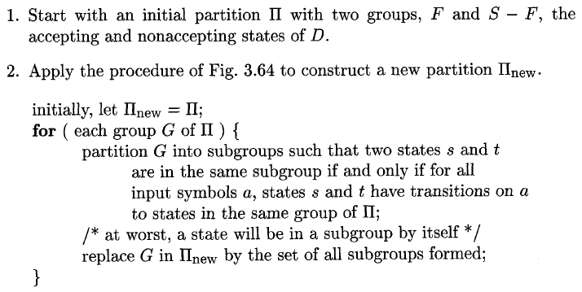

最小化DFA的算法

Slide 37

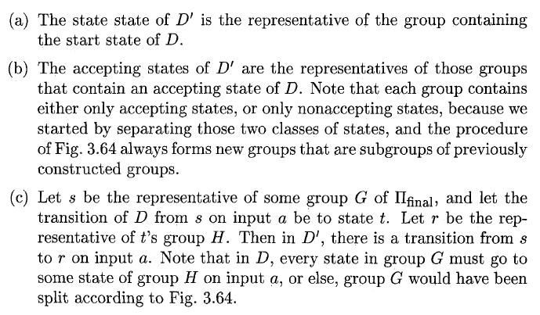
最小化DFA的算法（续）

Slide 38
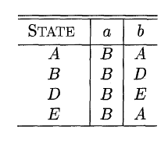
例子
最小化得

Slide 39
作业

Slide 40
See you next time!

